Slide 1
Chapter 5. Panel Data and ols
Financial Econometrics
Department of financial engineering
Zhongnan university of economics and law
Xu Yonghao

Slide 2
oUTLINE
Introduction: Data Structure
Policy Analysis（DoD）
Difference-in-Difference
Fixed Effect Model
Random Effect model
Reference - Wooldridge，Chapter 13 and 14；Greene， Chapter 11

Slide 3
1 Introduction: Data Structure
Cross-sectional data (截面数据):
Cross-sectional data, or a cross section of a study population, in statistics and econometrics, is a type of data collected by observing many subjects (such as individuals, firms, countries, or regions) at the one point or period of time. The analysis might also have no regard to differences in time. Analysis of cross-sectional data usually consists of comparing the differences among selected subjects.
For example, if we want to measure current obesity levels in a population, we could draw a sample of 1,000 people randomly from that population (also known as a cross section of that population), measure their weight and height, and calculate what percentage of that sample is categorized as obese. This cross-sectional sample provides us with a snapshot of that population
(Wikipedia)

Slide 4
1 Introduction: Data Structure
Pooled Cross-sectional data (混同截面数据):
Randomly sampled cross sections of individuals at different points in time.
Pooling makes sense if cross sections are randomly sampled (like one big sample)
Time dummy variables can be used to capture structural change over time
Observations across different time periods allows for policy analysis

Slide 5
1 Introduction: Data Structure
Panel Data (面板数据):
Observe cross sections of the same individuals at different points in time.
Time series and cross-sectional data can be thought of as special cases of panel data that are in one dimension only (one panel member or individual for the former, one time point for the latter).
A balanced panel is a dataset in which each panel member (i.e., person) is observed every year. Consequently, if a balanced panel contains N panel members and T periods, the number of observations (n) in the dataset is necessarily n = N×T.
An unbalanced panel is a dataset in which at least one panel member is not observed every period. Therefore, if an unbalanced panel contains N panel members and T periods, then the following strict inequality holds for the number of observations (n) in the dataset: n < N×T.

Slide 6
1 Introduction: some cases
Pooled Cross-sectional data
M&A . There are only a few M&A events, and therefore you need to pool the M&A events in separate years together.
House Price (on the house level); Lack of Data

Slide 7
1 Introduction: some cases
Panel Data
Students GPA, along with their age, gender, etc.
CHFS (China Household Finance Survey), with households being survey every year.
Provincial economic data since 1949.
Key: Each individual/province/subject i gets an observation from time t to t+n.

Slide 8
2 Policy Analysis（DoD）
Event Study is not suitable for analysis of macroeconomic policies, because in most cases, the issues are not financial markets. However, there are a lot of policies that need to be evaluated.
1. Tax of Real Estate and House Price.
2. Zhai Tianlin event, and quality/length of doctoral thesis.
3. Covid-19 Shock and household physical/mental health.
4. Option and stock market efficiency.
5. law of disclosure and accounting quality.

Slide 9
2 Policy Analysis
The common method is to compare the situation before and after the implementation of the policy to see if there is any change.
For example, the impact of Shanghai's real estate tax on housing prices can be evaluated from the changes in housing prices before and after the policy.
This is also a pooled cross sections data, which can be tested by regression with dummy.
The regression with dummy is simple and easy to operate, but is it accurate?
In most cases, the regression with dummy is not enough.

Slide 10
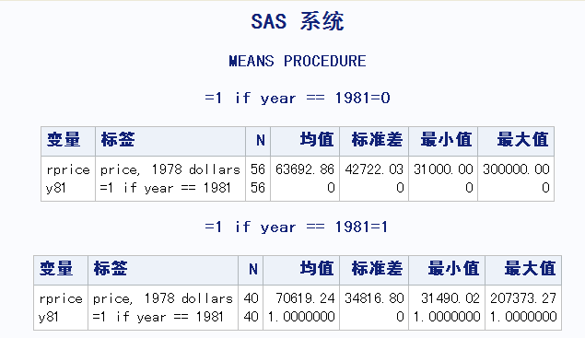
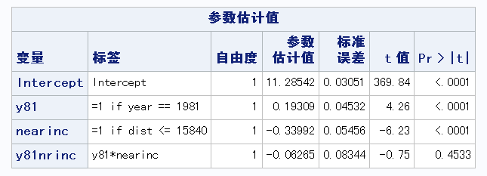
2 Policy Analysis
Let's look at the data on the impact of the construction of a garbage disposal site on the housing prices
Completed in 1985 with a rumor started in 1978.
It is likely that the price in 1981 will be lower than that of 1978
But the result is the opposite, why?
Because house prices are rising as a whole. What should you do?
Look at the prices that are not around. Therefore, it is important to know the difference between the peripheral and non peripheral areas.
Dummy regression can be used, and the price is logarithmic
What are the economic implications of the three coefficients?
But not significant, why?

Slide 11
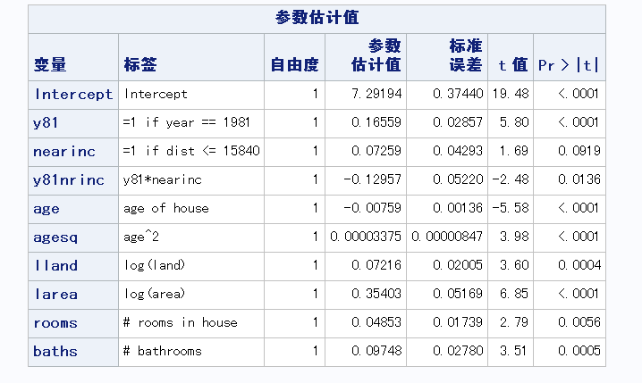
2 Policy Analysis
One possible reason:
In the data of 78 years, most of the houses near the garbage dump are old ones; In the year of 81, there were many new houses near the dump. So the relatively high house prices near the garbage dump in 1981 were caused by sampling differences.
Or the characteristics of other sampling houses are different: size, number of rooms, etc.
So in the regression model, we should control these factors.
To test the difference (DoD) between the mean values of four groups, as a common method of policy evaluation, regression method is used instead of direct t-test.

Slide 12
2 Policy Analysis
However, the DoD might not work in many cases:
If there are only large houses (size=2) near the dump, while other houses outside of the dump are all small houses (size=1). Is controlling size effective?
Collinearity with near.
Or are all big houses (size=2) in 78 and small houses (size=1) in 81? Is size control effective?
Collinearity with y81
Therefore, the DoD method to test the difference between the mean values of four groups of samples are constraint in the following assumptions.
There are samples that are not affected by the policy
All other factors should be controlled for
These factors should be equally distributed among the four groups of samples.
Therefore, simply comparing prices before and after the event is not an effective method for policy evaluation

Slide 13
3 Difference-in-difference (DID)
The previous method (DoD) has another problem
In the previous housing price problem, even if we assume that these characteristics are almost evenly distributed among the four groups of samples, consider this situation:
The appearance and internal structure of the houses near the garbage dump in 78 years are in better shape, while those sampled in 81 years are very poor
The appearance and internal structure are "unobservable (measurable) factors", which cannot be controlled. What should you do?
If we can guarantee that the houses in 78 and 81 are the same house, there will be no such problem.
The same house appeared in the 78 and 81 years, that is, panel data.
Difference in differences. (2022, August 16). In Wikipedia. https://en.wikipedia.org/wiki/Difference_in_differences

Slide 14
3 Difference-in-difference (DID)
Difference in differences (DID) is a statistical technique used in econometrics and quantitative research in the social sciences that attempts to mimic an experimental research design using observational study data, by studying the differential effect of a treatment on a 'treatment group' versus a 'control group' in a natural experiment.
It calculates the effect of a treatment (i.e., an explanatory variable or an independent variable) on an outcome (i.e., a response variable or dependent variable) by comparing the average change over time in the outcome variable for the treatment group to the average change over time for the control group.
Although it is intended to mitigate the effects of extraneous factors and selection bias, depending on how the treatment group is chosen, this method may still be subject to certain biases (e.g., mean regression, reverse causality and omitted variable bias).
Difference in differences. (2022, August 16). In Wikipedia. https://en.wikipedia.org/wiki/Difference_in_differences

Slide 15
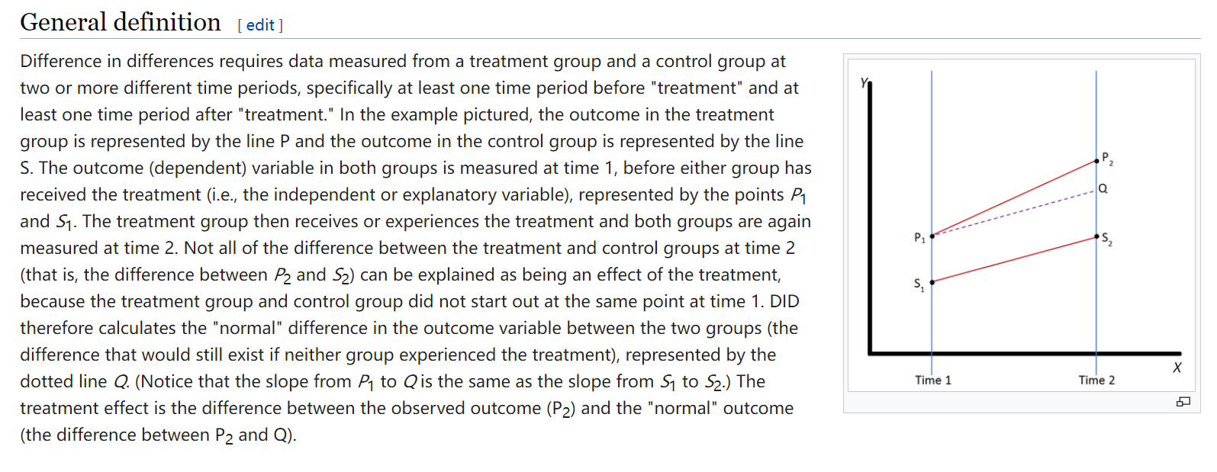
3 Difference-in-difference (DID)
Difference in differences. (2022, August 16). In Wikipedia. https://en.wikipedia.org/wiki/Difference_in_differences

Slide 16
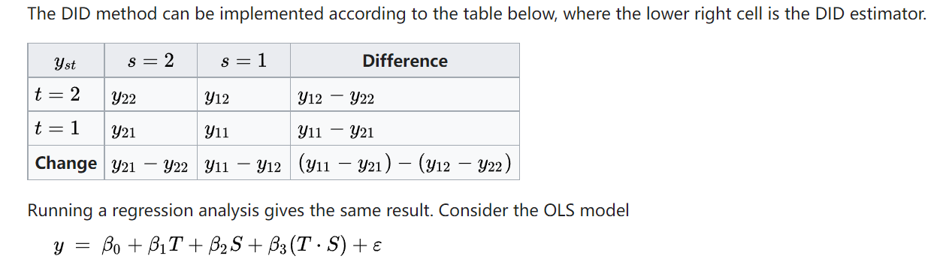
3 Difference-in-difference (DID)
Difference in differences. (2022, August 16). In Wikipedia. https://en.wikipedia.org/wiki/Difference_in_differences

Slide 17
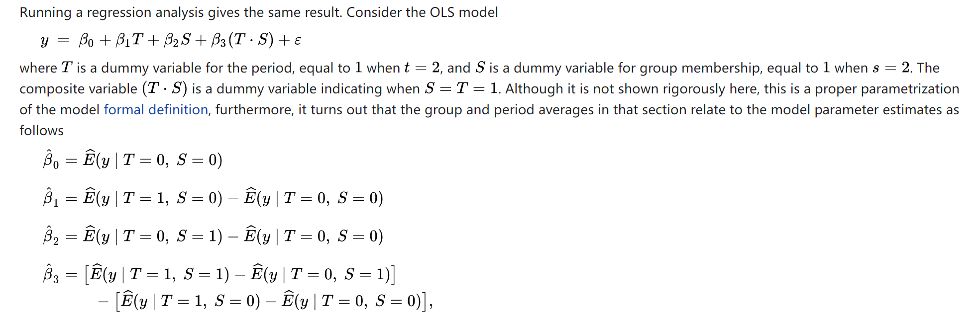
3 Difference-in-difference (DID)
Difference in differences. (2022, August 16). In Wikipedia. https://en.wikipedia.org/wiki/Difference_in_differences

Slide 18
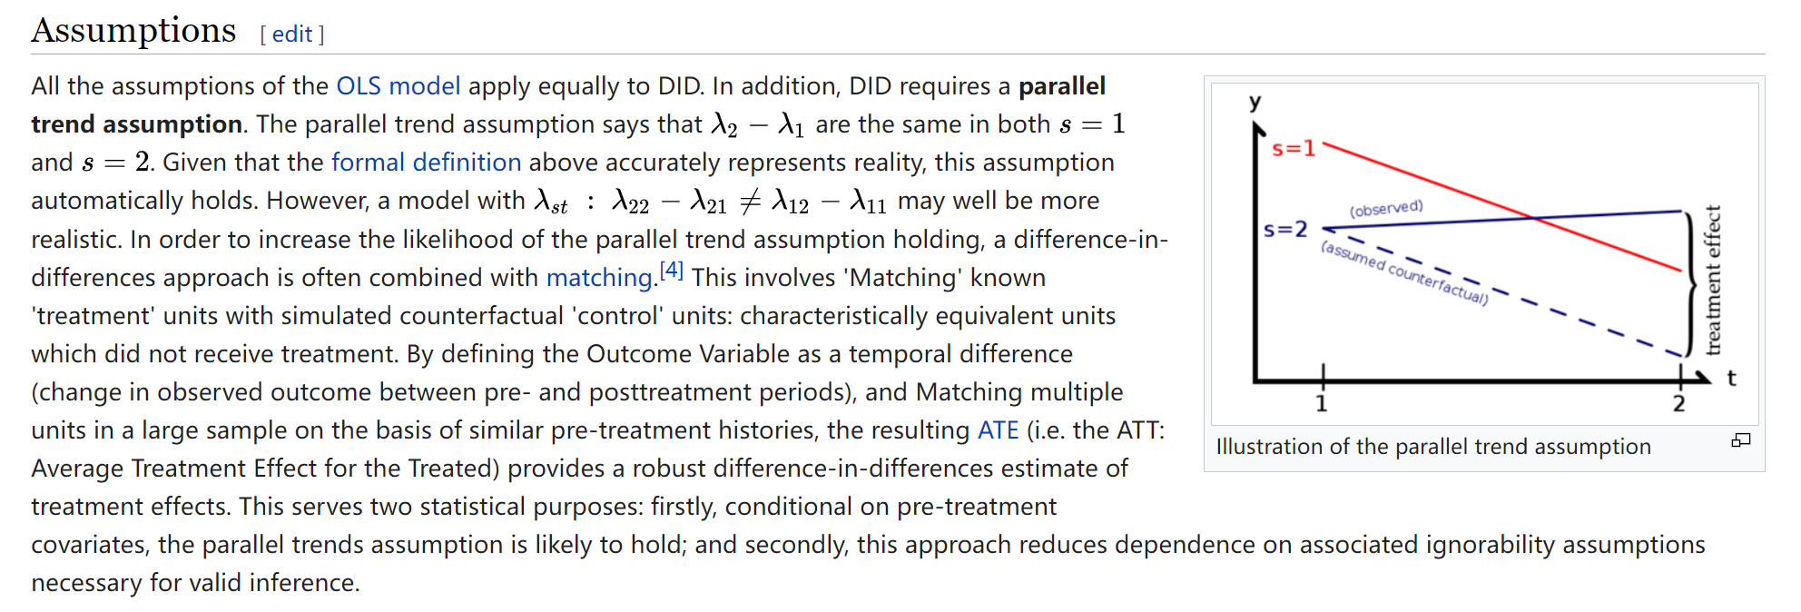
3 Difference-in-difference (DID)
Difference in differences. (2022, August 16). In Wikipedia. https://en.wikipedia.org/wiki/Difference_in_differences

Slide 19
3 Difference-in-difference (DID)
If we have panel data, we can use DID, that is, investigate the difference between the two regions in the price difference of the same house (78 and 81 years)
In the regression of the DoD, the interaction term reflects the difference among the differences, but it is not DID
The specific method of DID is:
Why can the regression of dy solve the problem of unobservable factors?
If it is panel data, we have
After difference, all invariant features (including unobservable factors) are subtracted. And get the above difference equation model1

Slide 20
3 Difference-in-difference (DID)
But DID also has its problems.
If most houses near the dump site are small houses, while the others are big houses, the coefficient of nearinc in the DID setting is significant, but might be caused by the surge of big houses, not the dump site.
In the event study, if too many events happened at the same time, the differences are hard to be interpreted by a single event.
The DoD in pooled Cross Section regression requires for similar sample between four groups, but DID only requires for the parallel trend, and it does not requires for the differences between treatment and control.
In the estimation of policy, the ideal setting is that treatment group and control group are the same.
Otherwise, in addition to selecting two groups as close as possible, control variables are needed, that is, adding control variables to the regression.

Slide 21
3 DID - exogenous
A natural experiment occurs when some exogenous event—often a change in government policy—changes the environment in which individuals, families, firms, or cities operate.
In a mouse experiment, the mice have no right to decide which mice participate in the treatment, and therefore satisfying the exogenous requirement.
In natural experiments, this is not necessarily the case.
For example, in the evaluation of labor training policies, we can compare the changes in salaries of two groups: one group participates in training, and the other group does not. However, it is not entirely up to the experiment organizer to decide whether to participate in the training or not, and the participants in the experiment have a great right to decide.
In essence, these two types of people are different, one is willing to participate in training, the other is unwilling. But we can't see these differences and can't control them.
This is equivalent omitting a factor that affects the value of the dummy variable, leading to endogenous problems.
Heckman treatment effect model is a model to deal with such problems. It is essentially a instrumental variable regression.

Slide 22
4 DID - classwork
Discuss examples/events that satisfy the DID setting.

Slide 23
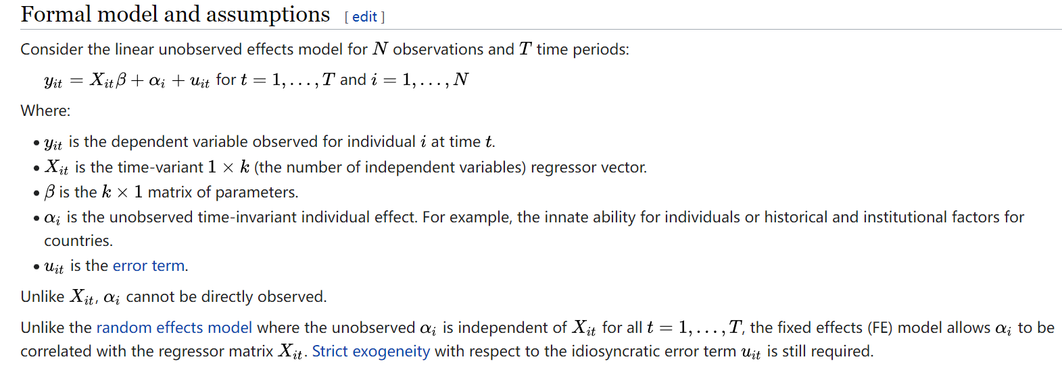
4 Fixed effect model
Fixed effects model. (2022, August 8). In Wikipedia. https://en.wikipedia.org/wiki/Fixed_effects_model

Slide 24
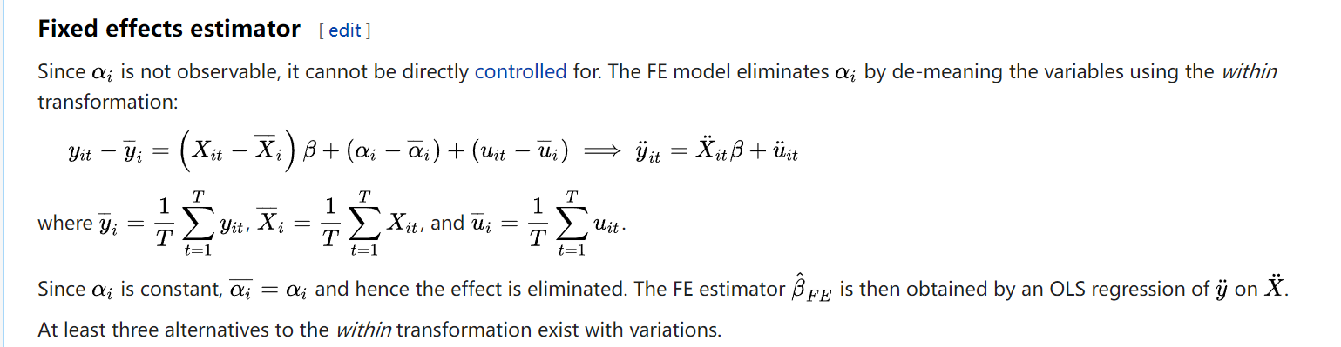
4 Fixed effect model
Fixed effects model. (2022, August 8). In Wikipedia. https://en.wikipedia.org/wiki/Fixed_effects_model

Slide 25
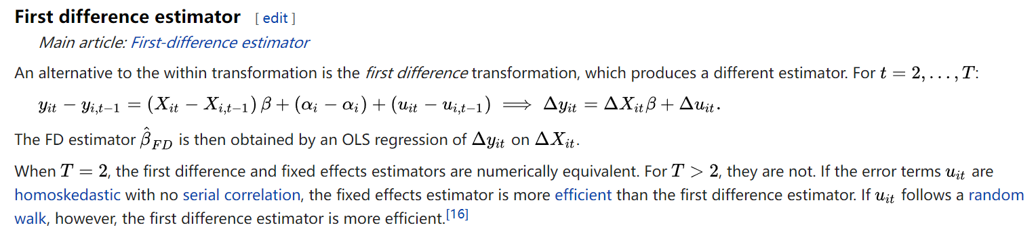
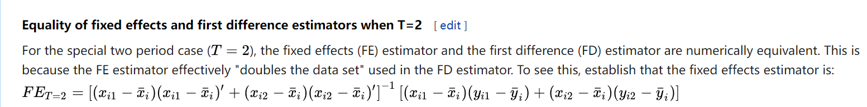
4 Fixed effect model
Fixed effects model. (2022, August 8). In Wikipedia. https://en.wikipedia.org/wiki/Fixed_effects_model

Slide 26

4 Fixed effect model
For fixed effect model
It can be rewritten or
This is the between effect model, which captures the changes between groups
The model (3) is the within effect model, which captures the changes within groups.
The beta in model 1 is equal to the beta in model 3.
Usually, R2=SSE/SST。
The R2 in model (3) is the within effect R2。

Slide 27
4 Fixed effect model
Two-way fixed effect model
In most cases, we need to control for the time fixed effect.
This is called two-way fixed effect model.
DID in Panel data.
In panel data (fixed effect model), if it is the two-way fixed effect (time and individual), the interaction term of dummy variables is equivalent to DID.
Note: if the events happened in multiple times, the above statement is half true, the details will be discussed in the postgraduate courses.

Slide 28
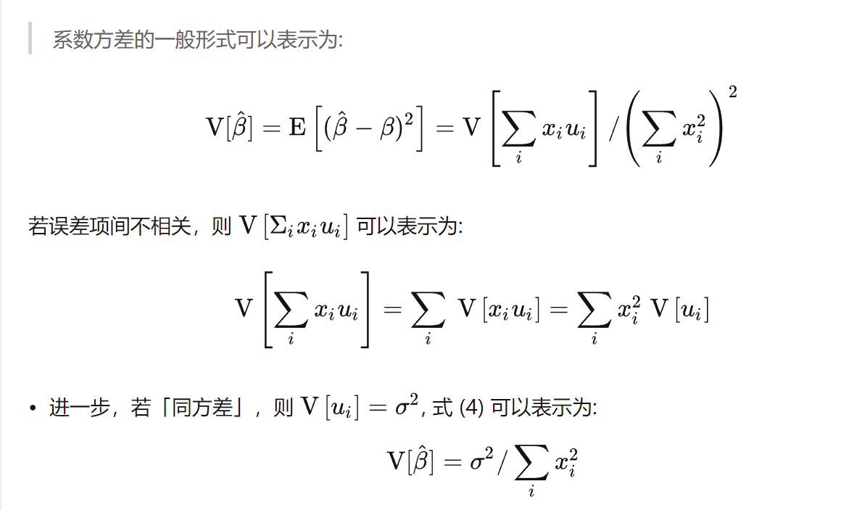
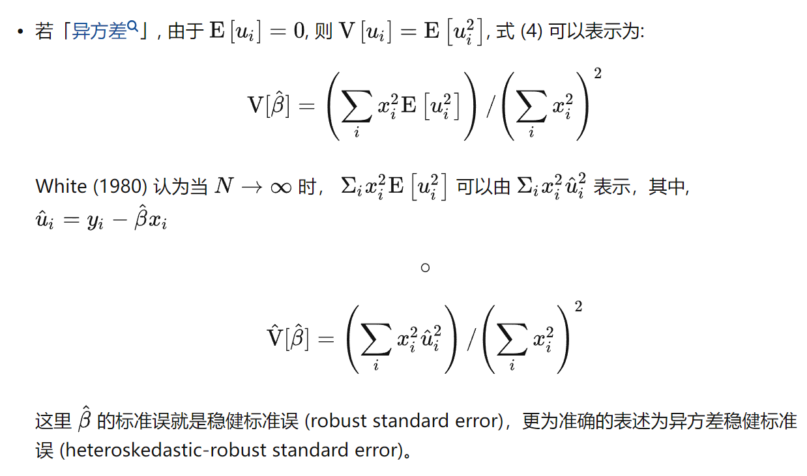
4 Fixed effect model
连玉君 stata讲义

Slide 29
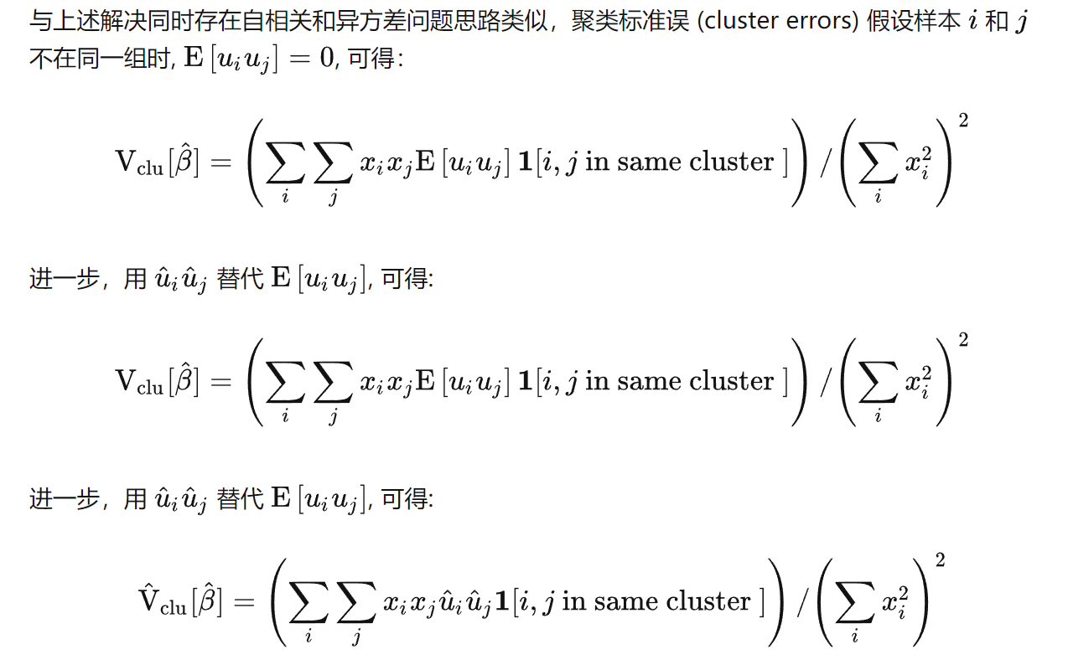
4 Fixed effect model
连玉君君 stata讲义

Slide 30
4 Fixed effect model
In the two-way fixed effect model
In most cases, you should at least cluster the S.D. on the individual level.
In certain cases, you should cluster the S.D. both on the individual and time level.

Slide 31
5 Random effect model
Fixed effect model is generally -
In the fixed effect model, no matter u_{i} and X_{it} are correlated or not, the coefficient of this model can be estimated by adding dummies.
However, if u_{i} and X_{it} are not correlated, and the R square of model is not what you care about, while the beta and the corresponding tests are the main concerns, then estimating so many dummies are not the best way.
The errors terms are intended for factors (or structures) that could not be included in the model, or did not want to be included.
Therefore, we can include these u_{i} in the error terms and estimated the results using GLS
Or, the u_{i} are assumed to be randomly distributed with a mean of zero and a constant variance, u_{i} ~ IID(0, σ²_{u}).
For each individual, the observation is a realization, and fixed
This is called Random effect.
But，if u_{i} and X_{it} are correlated, the random-effects estimates are biased.

Slide 32
5 Random effect model
Hausman test:
We need to test whether u_{i} and X_{it} are correlated, The test was derived by Hausman （1978）
if u_{i} and X_{it} are correlated, the random-effects estimates are biased (inconsistent) while the fixed-effects coefficients are unbiased (consistent)
In this case, there will be a large difference between the random-effects and fixed-effects coefficient estimates
if u_{i} and X_{it} are uncorrelated, the random-effects and fixed-effects coefficients are both unbiased (consistent); the fixed-effects coefficients are less efficient while the random-effects coefficients are more efficient.
In this case, there will not be a large difference between the random-effects and fixed-effects coefficient estimates
The Hausman test indicates whether the two sets of coefficient estimates are significantly different

Slide 33

5 Random effect model
In the random effect model,
We can include ui in the error term,
Therefore causing serial correlation

Slide 34
5 Random effect model
Do we need to implement a panel regression when you get a panel data?
If you want to use the panel regression, F.E. or R.E.
Theoretically
Fixed effect, the most general model.
Allow Ui
Allow possible correlation between xi and Ui
Random effect
Allow Ui, but no correlation between xi and Ui
Can be treated as random variable with zero mean
Pooled cross-sectional model, the most restricted model.
No Ui
From the perspective of model selection, R.E. is like in the between of F.E. and OLS.

Slide 35
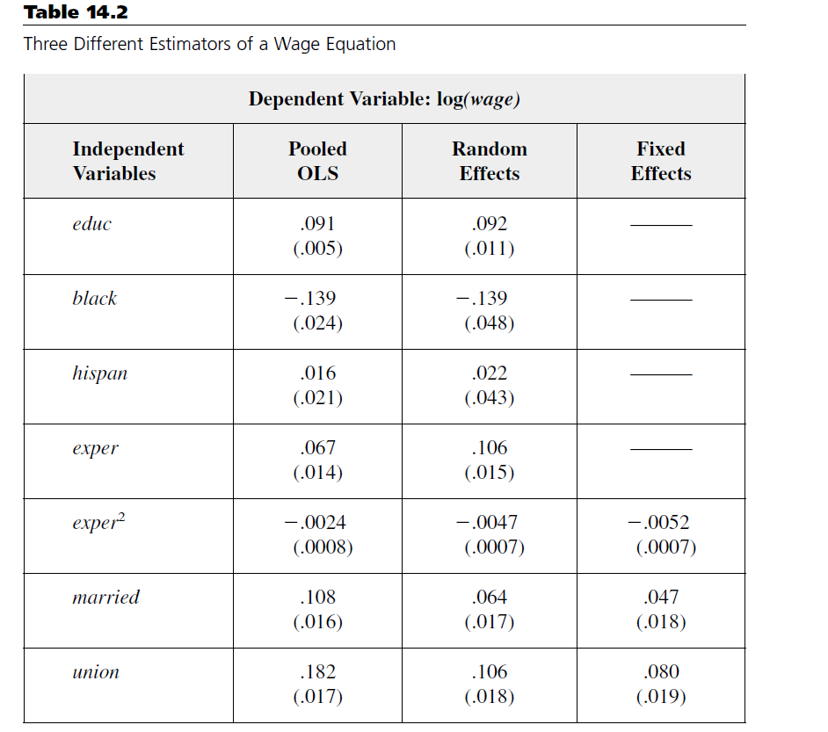
5 Random effect model
The coefficient of Married in the R.E. is smaller than that of OLS, but larger than the F.E.
Why does the coefficient of educ、black、hispan disappear in the F.E. model？
Explanatory variables that do not change over time enter the fixed effects ui
Why does the coefficient of exper also disappear in the F.E. model？

Slide 36
5 Random effect model
Which model to use in practice?
Economic intuition
Statistical test, from general to restricted
First, is it fixed effect or random effect?
Hausman test, H0: random effect
If it does not pass the test (refuse H0), then use F.E.
Otherwise, using BP (Breusch & Pagan, 1980) test to see whether using R.E. or OLS.
If it does not pass the test (refuse H0), then use R.E.
Otherwise, OLS with robust s.d.

Slide 37
5 Random effect model
Which model to use in practice?
It is important to recognize that the fixed effects estimator relies only on the time-series variation in Y and X within a given company
If the extent of time-series variation is small, In this case, the fixed effects estimator is not reliable because there is insufficient variation in either the dependent or treatment variable.
This point was made by Zhou (JFE, 2001) who criticized the use of fixed effects models when the treatment variable is management ownership.

Slide 38
6 Classwork
1 download the paper and data from 《中国工业经济》
http://ciejournal.ajcass.org/Magazine/show/?id=76559
《金融投资行为与企业技术创新——动机分析与经验证据》
2 Replicate the tables

